Slide 1

AMR HMI Solution
Jacob Hillebrand
Milien McDermott
Notes:
Jacob

Slide 2
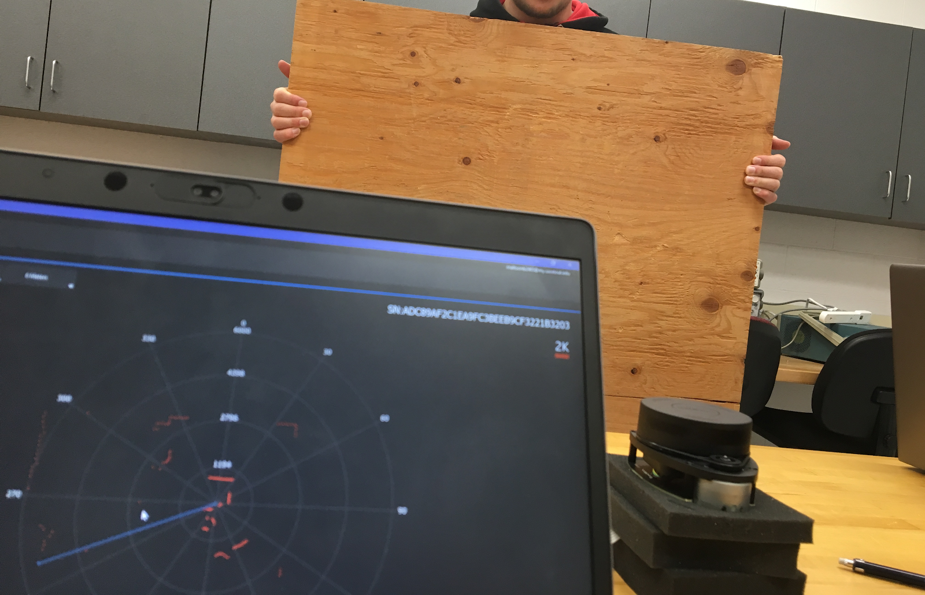
Project Description
Already designing an Automated Mobile Robot (AMR) for Capstone I
AMR uses:
Raspberry Pi for control
LIDAR sensor for guidance
Orientation sensor for guidance correction
The Raspberry Pi will use the sensors to build a map of its environment and perform navigation
Project Idea: Read the data from these sensors on an external device, either for the purposes of an HMI or for debugging purposes
Notes:
Jacob

Slide 3
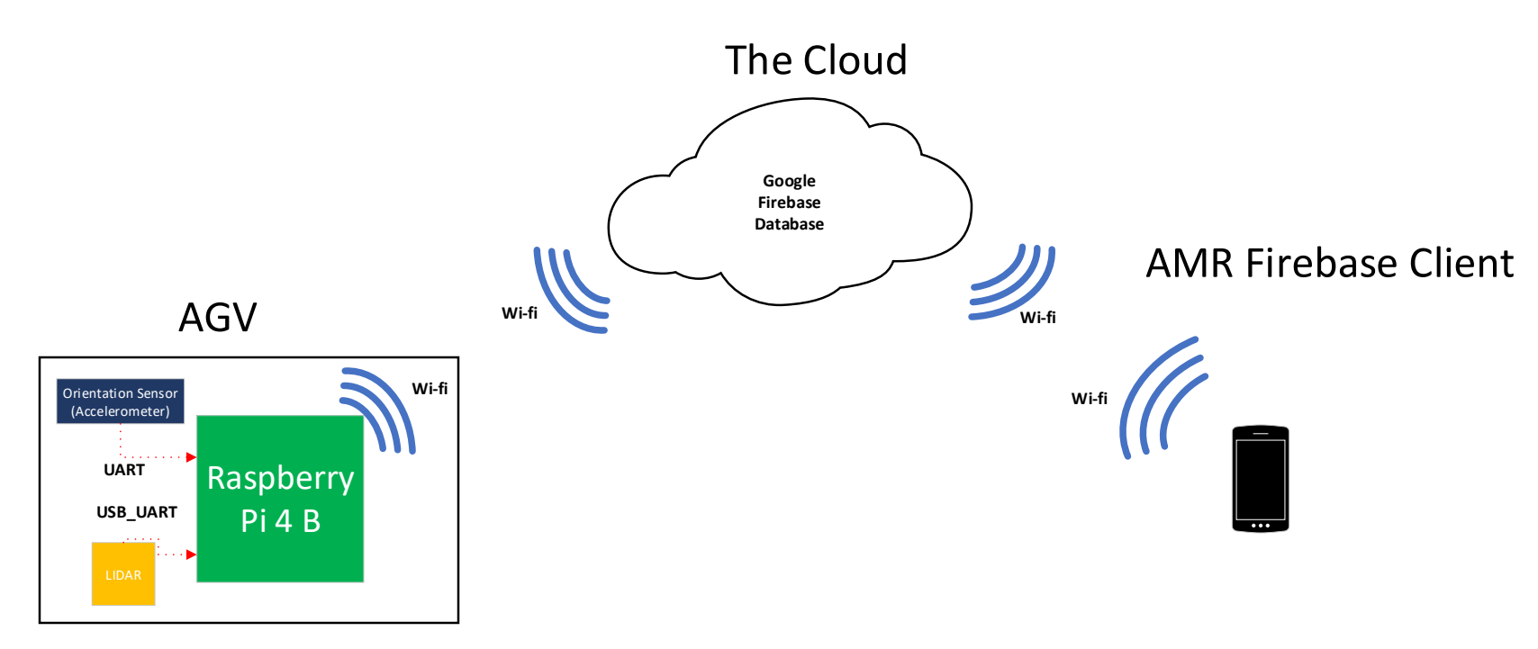
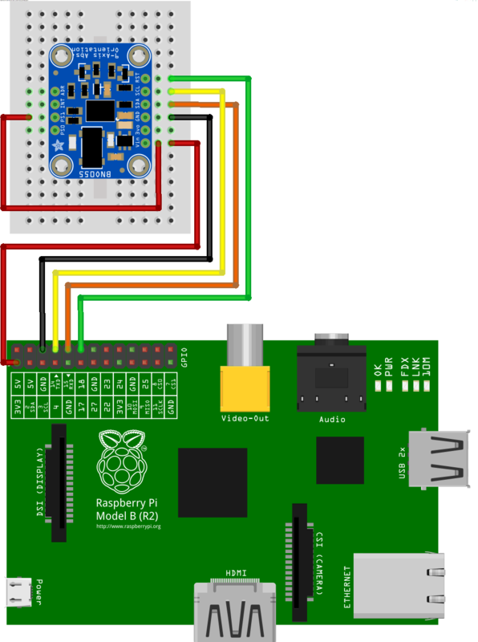
Wiring Diagram:
Notes:
Milien

Slide 4
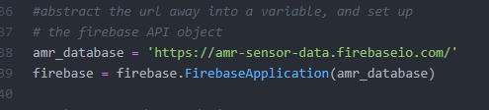
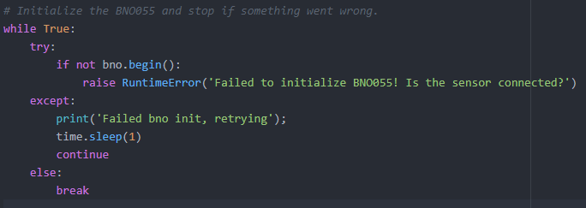
Code Execution Process – Raspberry Pi 4 (Python 2)
Initialize firebase database object with database URL
Initialize orientation sensor
Query orientation sensor for data
Notes:
Milien

Slide 5
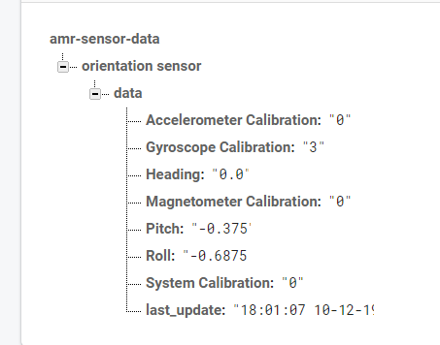
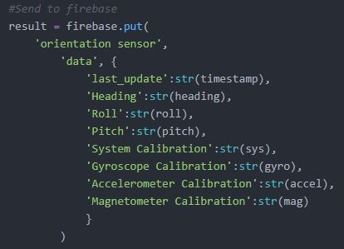
Code Execution Process – Raspberry Pi 4 (Python 2)
Assign data values to variables, parse to strings
Pass to json object, send “put” request to database to push data
Notes:
Milien

Slide 6

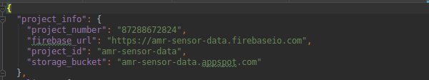

Code Execution Process – Android (Java)
Initialize activity with textview objects and button
Initialize firebase object based on data from google-firebase.json configuration file
When button is pressed, place listener object on database
Notes:
Jacob

Slide 7
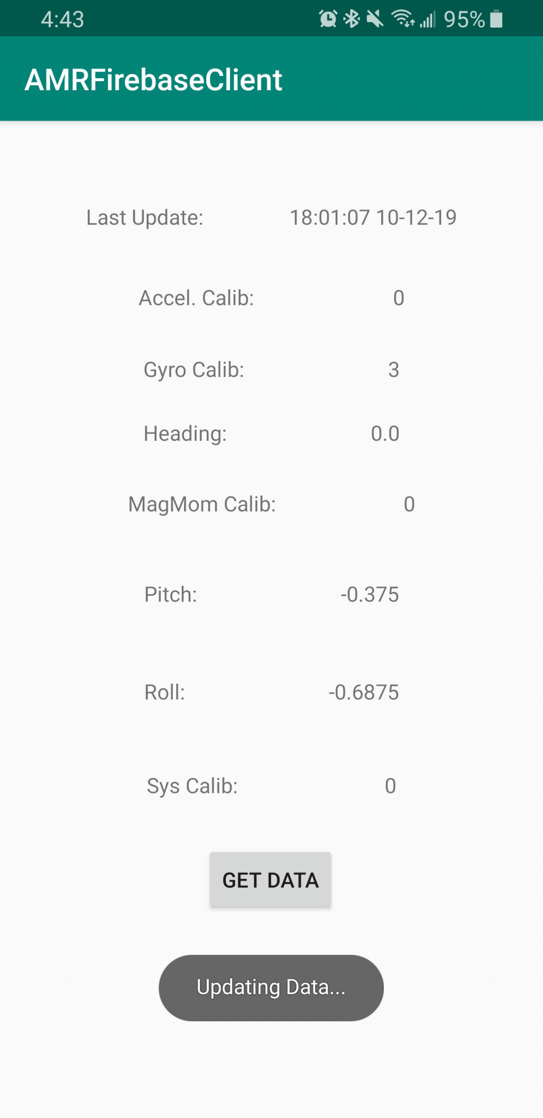
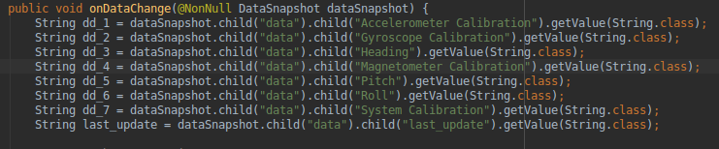
Code Execution Process – Android (Java)
When database updates, pull data to Android device
Update textview objects as data comes in
Notes:
Jacob

Slide 8
Bill of Materials
Raspberry Pi 4 | Amazon | https://www.amazon.com/dp/B07TC2BK1X/ref=twister_B07TN34PCN?_encoding=UTF8&psc=1 | 1 | $62.00 | $62.00
Cooling Fan | Amazon | https://www.amazon.com/dp/B07DXS86G7/ref=emc_b_5_t | 1 | $13.95 | $13.95
Heatsinks | Amazon | https://www.amazon.com/gp/product/B014KKY3KI?tag=tv-auto-20 | 1 | $7.66 | $7.66
Samsung 128Gb Microsd card | Amazon | https://www.amazon.com/Samsung-MicroSDXC-Adapter-MB-ME128GA-AM/dp/B06XWZWYVP/ref=sr_1_3?keywords=microsd+card&qid=1570463741&sr=8-3 | 1 | $19.99 | $19.99
Mini HDMI to HDMI | Amazon | https://www.amazon.com/GANA-Adapter-Female-Action-Supported/dp/B07K21HSQX/ref=pd_bxgy_147_2/143-9673664-1489037?_encoding=UTF8&pd_rd_i=B07K21HSQX&pd_rd_r=56e51a1a-afca-444b-aae9-4fd377e6abda&pd_rd_w=M4BAd&pd_rd_wg=OGtPJ&pf_rd_p=3edd75bb-e36e-488e-b666-80dd1a52c658&pf_rd_r=9HN6TKRC5CWM01ZZD71C&psc=1&refRID=9HN6TKRC5CWM01ZZD71C | 1 | $7.99 | $7.99
BNO055 Absolute Orientation Sensor | Amazon | https://www.amazon.com/Adafruit-Absolute-Orientation-Fusion-Breakout/dp/B017PEIGIG | 1 | $32.00 | $32.00
Google Firebase | Google | https://firebase.google.com/ | n/a | $0 | $0
Notes:
Milien

Slide 9
Stumbling Blocks & Conclusion
Original Plan – Use BLE for communication, and ROS for message passing
Difficult to set up from Android side
Difficult to pass data from ROS
Required more time than we had for the class
Buggy Python firebase libraries
python-firebase only works on Python 2
throws an error if it can’t establish a connection first try
Required implementation of exception handling and timers
Raspberry Pi Connectivity
Short DHCP lease times resulted in repeated IP address cycling
Minor annoyance, lost work if not saving frequently
Conclusion?
We enjoyed the project, and learned a lot
Just not about the things we thought we were going to learn about
Notes:
Jacob

Slide 10
Demonstration
https://jakehill.jackhil.de/s/4idjfMTwnB2Sfgn
Notes:
Both of Us

